Slide 1
Python Data Analytics/Science: NumPy, Pandas, MatplotLib, Seaborn, ScikitLearn (SkLearn)

Slide 2
NumPy
NumPy: Foundation of Python Data Analytics
Library for creating N-dimensional arrays of various data types
More efficient than lists: Homogeneous unlike lists (All elements are of the same type) and are stored in contiguous memory locations
Vectorization: Apply a function/operation simultaneously on entire arrays, without needing a for loop, e.g. result = arr + 5
Broadcasting: Align arrays of different shapes, e.g. result = arr_2d + arra_1d
Linear algebra: Matrix, Eigenvalues/Eigenvectors, etc
Statistical functions: Mean, Mode, Median, Standard deviation, Covariance, etc
Random number generation: From uniform, normal, binomial distributions
Missing data: Can handle missing data
Compatibility: With Pandas, Matplotlib, SciPy, TensorFlow, etc

Slide 3
NumPy Arrays
Main ways of creating a NumPy array:
Transform Python list
Use built-in functions
Generate random data
Indexing and Selection: Single element, Slicing, Broadcasting, 2D indexing and selection, Conditional selection
Operations on arrays: Arithmetic, Universal functions, Summary statistics, 2D arrays

Slide 4
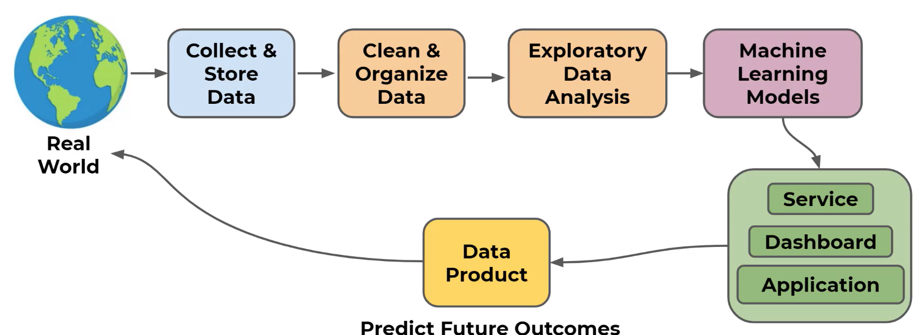
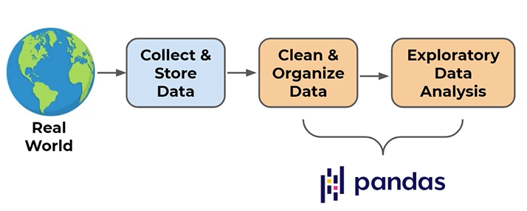
Pandas

Slide 5
Pandas
Pandas: Library for Data Analysis
Extremely powerful and flexible table (DataFrame) system built on top of NumPy
Computationally very efficient
Features
Read/Write data – Many formats supported
Indexing, Applying logic, Sub-setting, etc
Handle missing data
Adjust and restructure data

Slide 6
NumPy Compared to Pandas
NumPy
Pandas
Aim: Numerical computation using n-dimensional arrays
Data types: Mainly Integer, Float
Performance: Very fast
Indexing: Integer-based (e.g. array [0,1])
Built-in operations: Numerical and linear-algebra related
Time-series data: No support
Aim: Data processing using series and dataframes
Data types: Numeric, Text, Date
Performance: Relative slower
Indexing: Additionally also supports label-indexing (e.g. df[‘age’]
Built-in operations: Data analysis tools such as merging, sorting, joining, handling missing data, etc
Time-series data: Excellent support such as date-based indexing, shifting, resampling, etc

Slide 7
Pandas: Main Topics
Series and DataFrames
Conditional filtering and useful methods
Missing data
Grouping operations
Combining dataframes
Text methods and Time methods
Inputs and Outputs

Slide 8
Series
Series: A data structure that holds an array of information along with a named index
The named index distinguishes it from a NumPy array
NumPy array has numeric index
Pandas series has a labelled index
Note: Data is internally still numerically organized!
Index | Data
0 | 1776
1 | 1867
2 | 1821
Labelled Index | Data
USA | 1776
Canada | 1867
England | 1821
Numeric Index | Labelled Index | Data
0 | USA | 1776
1 | Canada | 1867
2 | England | 1821
Finding data using this index is not easy
Finding data using this index is very easy
We can still use the numeric index, if we want

Slide 9
DataFrame
DataFrame: Table of columns and rows that can be easily restructured/filtered
So, Dataframe = Several series that share the same index, like a spreadsheet
Series
Multiple Series with the Same Index
Dataframe
Index | Year
USA | 1776
Canada | 1867
England | 1821
Index | Year
USA | 1776
Canada | 1867
England | 1821
Index | Pop
USA | 328
Canada | 38
England | 126
Index | GDP
USA | 20.5
Canada | 1.7
England | 3.9
Index | Year | Pop | GDP
USA | 1776 | 328 | 20.5
Canada | 1867 | 38 | 1.7
England | 1821 | 126 | 3.9

Slide 10
DataFrame
Basic operations
Create a dataframe
Select a column/multiple columns
Select a row/multiple rows
Insert a new column/row
Advanced Operations
Indexing
Filtering
Missing data
Grouping
Joining

Slide 11
MatplotLib
Data visualization is very important to quickly understand trends and relationships in the data
Matplotlib: One of the most popular plotting libraries in Python
Grandfather of plotting and visualization libraries in Python
Seaborn/Pandas built-in visualization are built on top of Matplotlib
Heavily inspired by the plotting functions in the MatLab programming language
Two approaches: (1) Functional (2) OOP
Main goals
Plot a functional relationship, e.g. y = 2x
Plot a relationship between raw data points: x = [1, 2, 3, 4] and y = [2, 4, 6, 8]
Main types of plots
Line Plot: Great for showing functional relationships and continuous data
Scatter Plot: Useful for plotting raw data points and understanding the correlation between two variables
Bar Plot: Useful for categorical data to show comparisons between different groups
Histogram: Good for showing the distribution of a single variable
Pie Chart: Used for showing proportions or percentages of categories

Slide 12
Matplotlib Approaches
import matplotlib.pyplot as plt
x = [1, 2, 3, 4]
y = [2, 4, 6, 8]
Functional
plt.plot(x, y) # Plotting using a simple functional call
plt.xlabel('x-axis')
plt.ylabel('y-axis')
plt.show()
Object-oriented
fig, ax = plt.subplots() # Create a figure and a set of subplots
ax.plot(x, y) # Plot on the axes object
ax.set_xlabel('x-axis') # Set label for x-axis
ax.set_ylabel('y-axis') # Set label for y-axis
plt.show()

Slide 13
Seaborn
Seaborn: Statistical plotting library
Built on top of Matplotlib, but uses a simpler one-line syntax
Can directly work with Python Dataframes
Easy to use, but less customization possible as compared to Matplotlib
Types of plots
Scatter plots: Relationship between two continuous variables (Trends, correlations)
Distribution plots: How a single variable is distributed (patterns, skew, outliers) (Histogram, KDE plot)
Categorical plots: Categorical variables and their relationships with continuous data (Box plot, bar plot, count plot)
Comparison plots: Compare two or more variables (pair plot)
Matrix plots: Complex relationship in a matrix form (heatmap)

Slide 14
Data Visualization Summary
Plot | Usage | Example | Code
Line plot | Trends over time periods/data points | Stock prices over a month | plt.plot([1, 2, 3], [4, 5, 6]); plt.show()
Scatter plot | Relationship between two numeric variables | House price versus Area of the house | plt.scatter([1, 2, 3], [4, 5, 6]); plt.show()
Bar plot | Compare categories/groups with respect to numeric values | Sales across product categories | plt.bar(['A', 'B', 'C'], [4, 7, 1]); plt.show()
Histogram | Distribution of a single numeric variable | Distribution of ages in a country | plt.hist([1, 2, 2, 3, 3, 3, 4, 4, 4, 4, 5, 5], bins=5); plt.show()
Box plot | Distribution of data with reference to minimum, Q1, Q2, Q3, maximum | Income distribution across professions | plt.boxplot([7, 2, 5, 13, 9, 6]); plt.show()
Heatmap | Matrix to display values using colour intensity | Correlation matrix between height and weight | sns.heatmap(np.random.rand(5, 5), annot=True); plt.show()
Pie chart | Proportions/percentages among categories | Market share of mobile phone brands | plt.pie([40, 30, 20, 10], labels=['A', 'B', 'C', 'D'], autopct='%1.1f%%'); plt.show()

